Slide 1

Project Name: Development of a model fault detection in solar panel
Team name: Group 4
Team Members: Dhruvi Ramani
Gokulakrishna N
Ms. Bhavya T.N
Rohit Ghadage
Mr. Jagadeesh CT
Snehal Kolhe
Koushik H V
Mentor Name: Ms.Bhanupriya
Date: 23/01/2022

Slide 2
Business Problem: Fault analysis and fault detection offers great opportunities to businesses for a smarter and more digital facility.
Business objective-
The aim of this project is to build a model to identify the faulty solar panels and help to reduce manufacturing errors.

Slide 3
Overview of PV System Faults:
The classification of faults occurring in a PV system can be categorized from different aspects. We classify such faults into three types: physical, environmental, and electrical. However, the classification of faults can also be made on other bases, e.g., location and structure .
Physical faults can be internal or external and generally include damage, cracks, and degradation in PV modules. Also, PV system failures are caused by the aging effect which is also a physical phenomenon.
Environmental faults include soiling and dust accumulation, bird drops, and temporary shading.
Permanent environmental faults include permanent shading due to the poor choice of installment location.
Hotspot faults in the PV modules can be caused by both permanent and temporary shading.
Lastly, electrical faults include open circuit, line-line, and ground faults, either in PV modules, arrays, or in the whole systems.
Open circuit faults are caused by the disconnection of wires in single or multiple branches of a PV circuit.
Line-line faults are created by unintentional low impedance current path in a PV array.
Ground faults are similar to line-line faults; however, the low impedance path is from current-carrying conductors to ground/earth.

Slide 4
Common solar panel defects
Hot Spots: Solar cells are designed to generate electricity from exposure to sunlight. However, as electric current flows through the solar cell strings, there may be some resistance due to hot spots. Very hot days can reduce the efficiency of a solar cell.
Microcracks: Technological advancements in the semiconductor industry have led to wafer-thin solar cells measuring around 170 μm thick – roughly twice the diameter of human hair. Due of their super thin construction, modern cells have become more brittle and prone to microcracks which can result in hot spots and poor energy generation. Here at Aztech Solar, we take exceptional care in handling and transporting solar panels to prevent microcracks during solar installation.
Broken Glass: Broken glass can make solar cells vulnerable to weather damage, and when water and dust are able to seep in under the glass, it can severely diminish the amount of light absorbed by the solar module.
Dust Build-Up: Dust build-up near the panel edges can significantly affect the energy production of your system. When solar panels are installed on rooftops that are flat or at a slight angle, there is a tendency for module frames to collect rainwater. As the water evaporates, dust residue is left behind and creates unwanted shade. Aztech Solar installs frames specially designed with sloping profiles and drainage channels to clear away rainwater and other debris.
Cracked Cells: The absence of robust quality control may lead to the accidental lamination of cracked solar cells into solar panels. When this happens, a mismatch is introduced to the cells, which can impact power generation. Automated production lines can screen out imperfect cells before ribbon soldering to minimise electric current resistance.

Slide 5
6) Poor String Connection: After solar cells are put together into strings, they are soldered into connected wires to complete the array inside a solar panel. When these interconnections are poorly soldered, the circuit remains open, reducing energy production by a whopping 30 per cent or more. An IR camera, which can show temperature differences among solar cell strings, can detect open circuits.
7) Defective Junction Box: Another cause for an open circuit is a defective junction box. The junction box at the back of a solar panel is key to conducting electricity from the solar system to your home. However, if dust or moisture seeps into the junction box, it can lead to a short circuit of the diodes inside.
8) Snail Trails: Even when the solar cells are broken, they can continue to generate electricity along the cracks. This, however, will cause localised heat to break down the cell surface which makes a pattern known as “Snail trails”. There may also be discoloured “snail trails” along microcracks if moisture is present. Unfortunately, apart from reducing power production, snail trails also give your panels a bad look. The best way to minimise this problem is to choose top-quality encapsulation materials that prevent water from entering the laminate.
9) Potential Induced Degradation(PID): Voltage, heat and humidity can cause PID on poor-quality solar modules, which can lead to reduced energy yield and cell damage. Solar panels are often connected in long series to produce enough voltage to drive solar inverters. However, when there is too much voltage difference between the grounded frames and solar cells, they may begin to deteriorate.
10) Cracked Backsheet: Solar modules are exposed to temperature fluctuations every day and, when there are cracks on the backsheets, water can seep into the module laminate and damage solar cells.

Slide 6







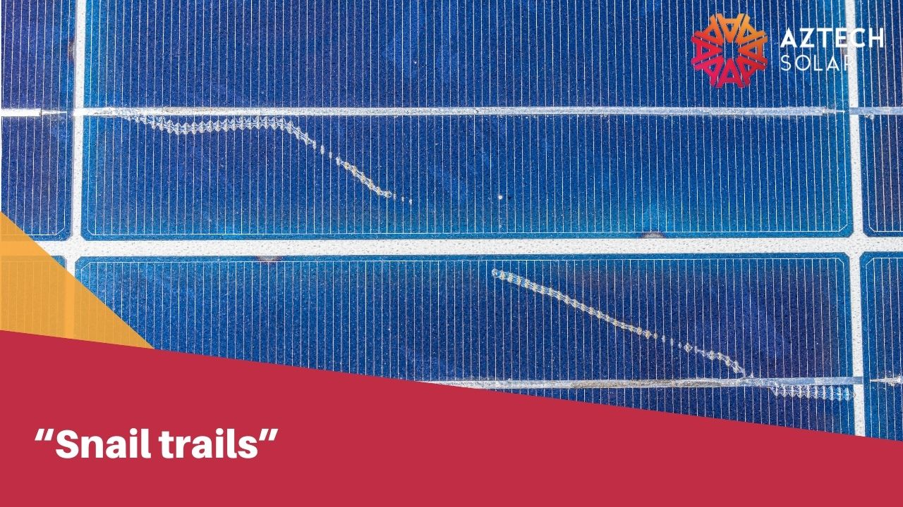


Slide 7
What Is Image Compression?
Image compression involves reducing the pixels, dimensions or color components of images in order to reduce their file size. This reduces their storage and processing burden (for web performance). Advanced image optimization techniques can identify the more important image components and discard less crucial components.
Applications of image compression include:
Storage — the compressed data takes up less disk space, which is particularly useful for archiving detailed images, such as medical images.
Principal component analysis (PCA) — image compression methods that extract the most significant components of an image are used for extracting or summarizing features and analyzing data.
Standardization — in some cases, sets of images must conform to a standard size and format, requiring compression of all images into the same size, shape and resolution. For example, records maintained by security and government agencies require standardized images.

Slide 8
Image Compression with Deep Learning
Deep Learning (DL) has been used for image compression since the 1980s, and has evolved to include techniques such as multi-layer perceptrons, random neural networks, convolutional neural networks and generative adversarial networks.
Multi-Layer Perceptrons: Multi-layer perceptrons (MLPs) have a hidden layer (or layers) or neurons sandwiched between a layer of input neurons and a layer of output neurons. Theoretically, MLPs with multiple hidden layers are useful for dimension reduction and data compression. Image compression with MLPs involves a unitary transformation of the entire spatial data.
Convolutional Neural Networks: Convolutional Neural Network(CNN)offer enhanced compression artifact reduction and super-resolution performance compared with traditional computer vision models. The convolution operations of CNNs allow them to determine how neighbouring pixels correlate. Cascaded convolution operations mirror the properties of complex images.
Generative Adversarial Networks: GAN image compression involves reconstructing a compressed image in a tiny feature space, based on the features from the input image. The main advantage of GANs over CNNs in terms of image compression is adversarial loss, which improves the quality of the output image. The opposing networks are trained together, against each other, enhancing the performance of the image generation model.

Slide 9
Convolutional Neural Networks:
Convolutional neural networks (CNN) – the concept behind recent breakthroughs and developments in deep learning.
CNNs have broken the mold and ascended the throne to become the state-of-the-art computer vision technique. Among the different types of neural networks (others include recurrent neural networks (RNN), long short term memory (LSTM), artificial neural networks (ANN), etc.), CNNs are easily the most popular.
These convolutional neural network models are ubiquitous in the image data space. They work phenomenally well on computer vision tasks like image classification, object detection, image recognition, etc.
it is challenging to incorporate a CNN model throughout the image compression process, as it requires gradient descent algorithms and backpropagation, which are challenging to incorporate in end-to-end image compression.
The first implementation of CNNs for image compression was in 2016, with an algorithm consisting of an analysis module and a synthesis module. The analysis module consists of convolution, divisive, and subsampling normalization stages. Each stage begins with an affine convolution, produces downsampled output, and then uses Generalized Divisive Normalization (GDN) to calculate the downsampled signals.

Slide 10
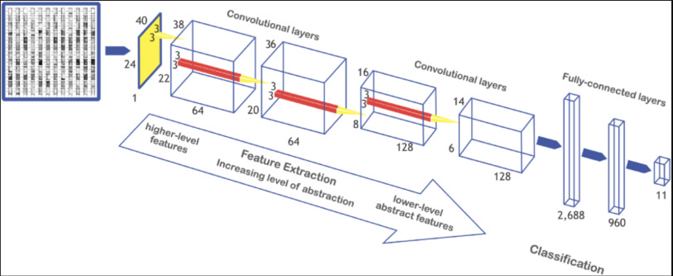
Project Flow
Data Collection
EDA
Model Building
(CNN)
Deployment

Slide 11

How To CNN work:

Slide 12
Exploratory Data Analysis (EDA)

Slide 13
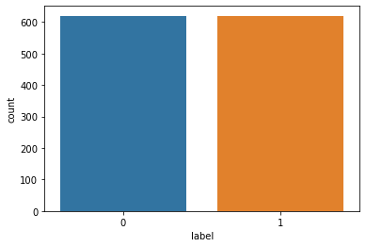

Exploratory Data Analysis (EDA)
In training dataset 620 faulty and 620 normal images and total 1240 images
And for testing 148 faulty and 148 normal images and total 296 images are present
Training Dataset
Test Dataset

Slide 14
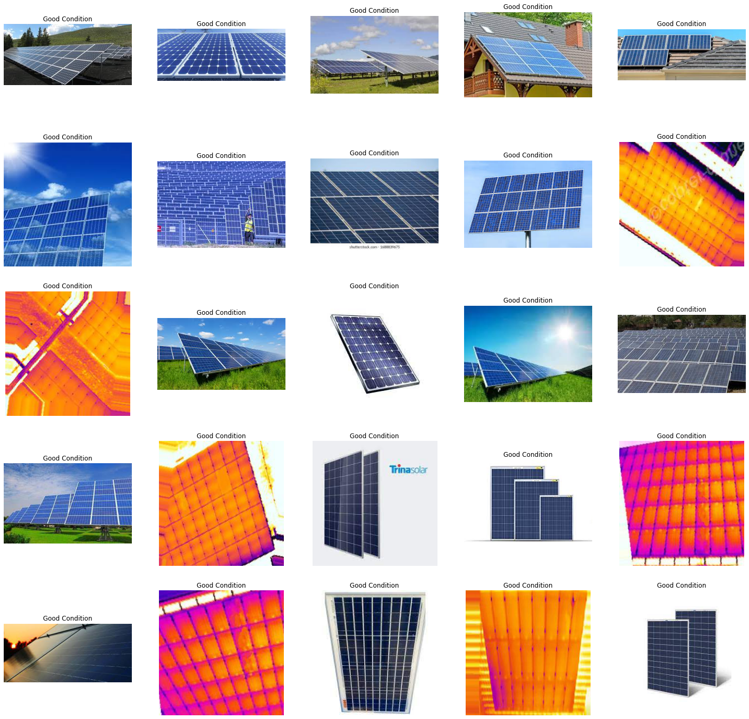
Normal Images

Slide 15
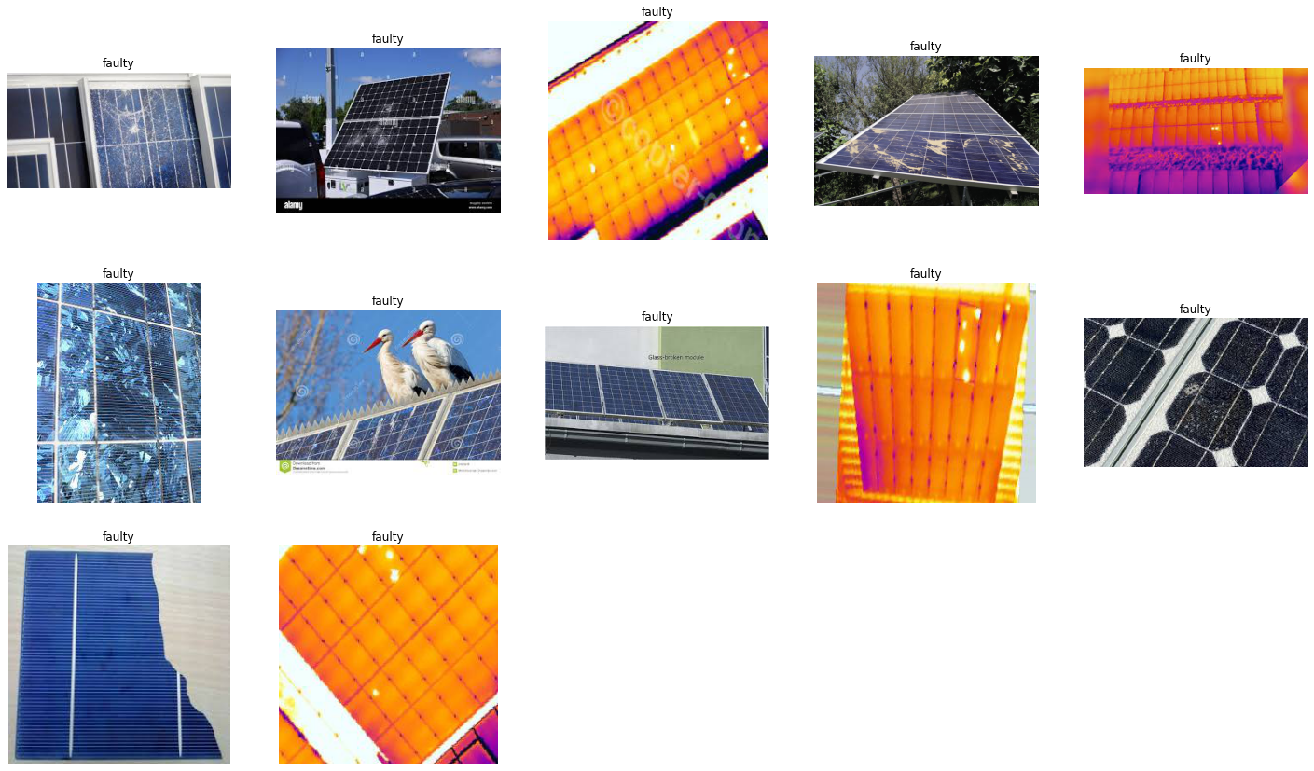
Faulty Images

Slide 16
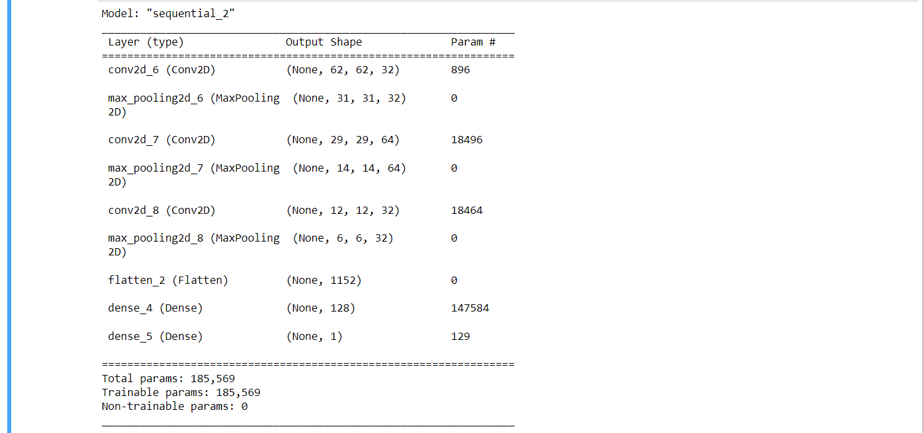
Model Building
Initialising the CNN
Step 1 - Convolution : A convolution is the simple application of a filter to an input that results in an activation.
Step 2 - Pooling: Pooling layers are used to reduce the dimensions of the feature maps
Step 3 - Flattening: Flattening is converting the data into a 1-dimensional array for inputting it to the next layer.
Step 4 - Full connection
Compiling the CNN
Summary Of Compiling Model

Slide 17
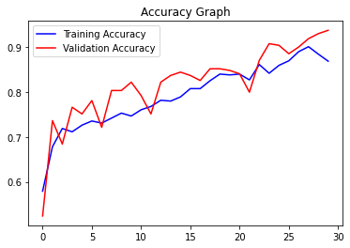
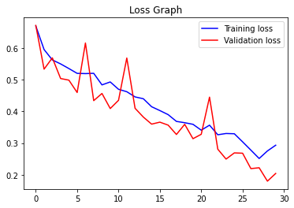
Model Building
Fitting the CNN to the images
1) For Training: Found 1084 images belonging to 2 classes.
2) For Testing: Found 269 images belonging to 2 classes.
Fit the model
Visualization Result

Slide 18

Deployment

Slide 19
Thank You

